Slide 1
The Nature of God

Slide 2
Goals of the Class
Open Dialogue
Quick Overview of Topics
Feel free to ask any questions – on topic or off. Everyone is at a different place.
Each topic will be covered over a week’s time, with plenty of opportunity for discussion.
Thought Questions to Consider
Flexibility
Content will be uploaded to the website for your review, with the goal being to stimulate your thoughts on the topic.
If more time is needed for a proper treatment of a subject, we’ll take the time to do it.

Slide 3
Topics of the Class
1. The Nature of God 2. Jesus, the Son of God 3. The Holy Spirit 4. The Devil 5. What is Sin? 6. Redemption and Salvation
7. The Judgment 8. Faith 9. Repentance 10. Baptism 11. The Church 12. Christian Character 13. Love
14. Forgiveness 15. Sexuality 16. True Worship 17. Communion 18. The Resurrection
19. Church Relationships 20. Unity Among Believers 21. Inspiration of Scripture 22. How to Study the Bible 23. Generosity 24. Evangelism 25. Prayer
26. Family Relationships

Slide 4
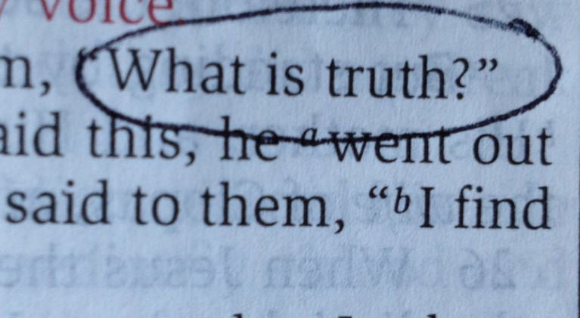

Slide 5
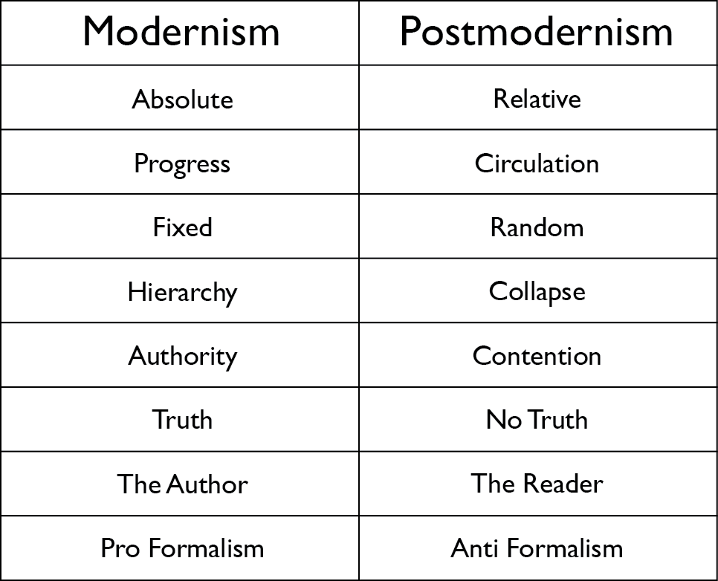

Slide 6
Our ability to know God is based on His ability to communicate to us in a way that is understandable and actionable.

Slide 7
So Jesus said to the Jews who had believed him, “If you abide in my word, you are truly my disciples, and you will know the truth, and the truth will set you free.”

Slide 8
Look carefully then how you walk, not as unwise but as wise, making the best use of the time, because the days are evil. Therefore do not be foolish, but understand what the will of the Lord is.

Slide 9
The Nature of God

Slide 12
Why Understand God?
But Pharaoh said, “Who is the LORD, that I should obey his voice and let Israel go? I do not know the LORD, and moreover, I will not let Israel go.”

Slide 13
Why Understand God?
You can’t love what you don’t know.
Incomplete ideas lead to wrong conclusions.
Faith is based on the revelation of who God is.

Slide 14
God is Spirit
Important things about God
(John 4:24)
What are some implications of God not being physical?
He transcends human limitations (Isaiah 40:13)
He doesn’t have physical passions (Isaiah 40:13)
He doesn’t need earthly things (Acts 17:25)

Slide 15
God is Sovereign
Important things about God
(Job 42:2)
What role does God play in the affairs of men?
He has the ability purpose and plan (Ephesian 3:1-4)
He has personal awareness and concern (Luke 12:6-7)
He still holds us accountable for our actions (Ezek 18)

Slide 16
God is Love
Important things about God
(1st John 4:8)
How can we misunderstand the concept of God’s love?
He gives whatever is needed (John 3:16)
His love is consistent with his character (Hebrews 12:3)
His love is for everyone (Genesis 12)

